Slide 1


EDA Project E-Perfume
Amal Al-Shihabi

Slide 2

The goal of this project is to discover the best_selling men's and women's perfume scents in online stores and the most rated brand from buyers to find out what people care about most is the base note or perfume brand
Introduction

Slide 3
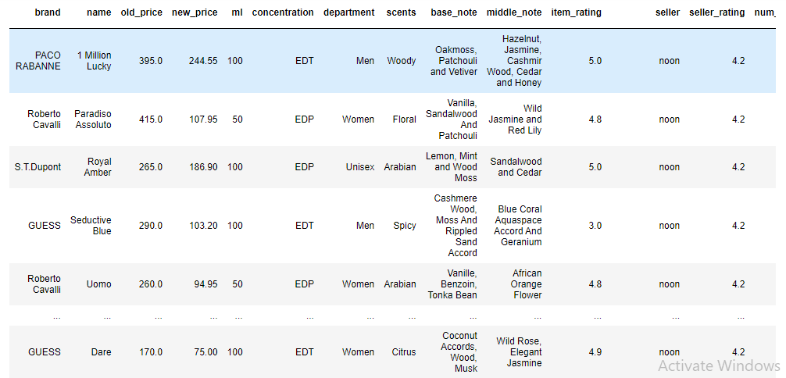
Data Structure
Applying data analytics to Noon website data on the perfume department
Data released in January 2021
1003 rows, 15 columns

Slide 4
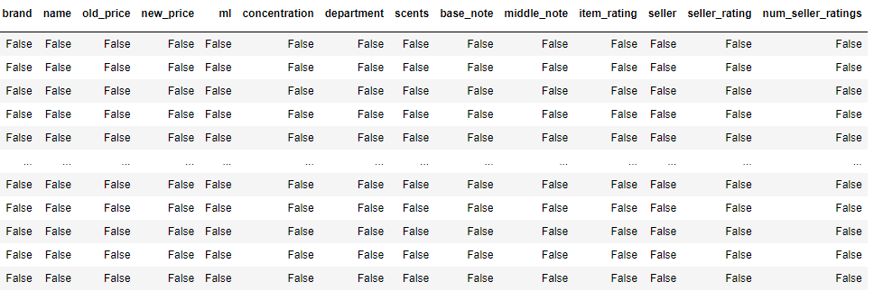
Data cleaning
I didn't have any nulls in the data
Only one column of the spreadsheet has been dropped

Slide 5
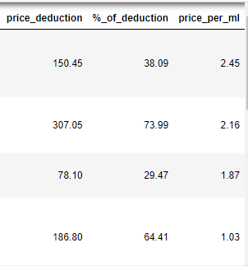
Three columns have been added:
Added price_deduction column to see the price difference between the old price and the new price
Add a column that calculates the discount from 100%
A column has been added to know the price of each ml
Data Analysis

Slide 6

Question:
What are the top 10 scents for men and women?
What brands get a high rating?
Do women's perfumes get a bigger discount or men's perfumes?
Are people more interested in the composition of the fragrance than the brand or vice versa?
What category cares more about a brand than the ingredients of a perfume?

Slide 7
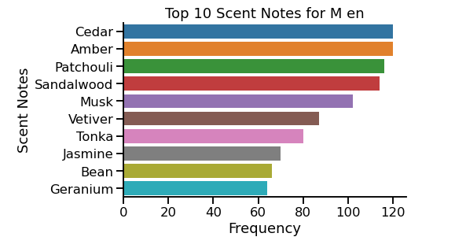
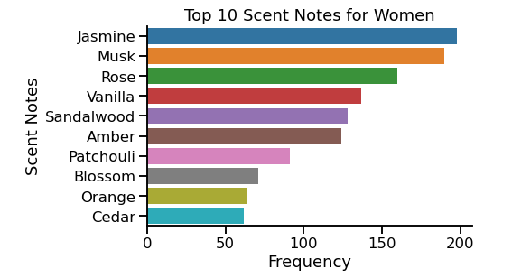
What are the top 10 scents for men and women?

Slide 8
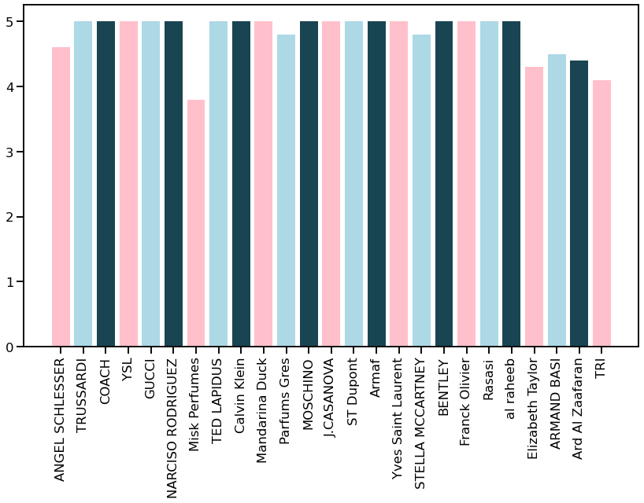
What brands get a high rating?
for example: GUCCI, CALVIN KLEIN

Slide 9
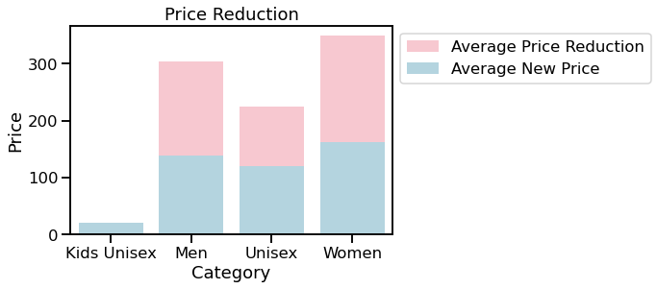
Do women's perfumes get a bigger discount or men's perfumes?

Slide 10
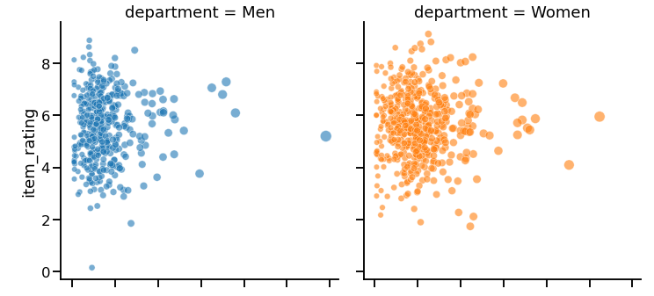
Are people more interested in the composition of the fragrance than the brand or vice versa?

Slide 11
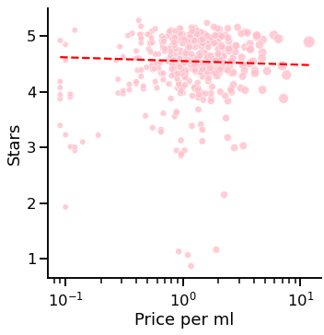
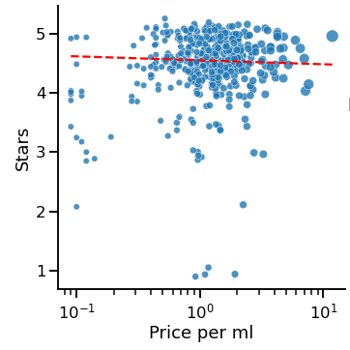
What category cares more about a brand than the ingredients of a perfume?

Slide 12
Conclusion
It became clear to us from the analysis of perfume data for both sexes that the higher the price of a perfume, the higher its value and the greater the demand for it.
In the next step, we want to know what caused the interest in brand perfumes, as opposed to paying attention to the composition of the perfume

Slide 13
THANK YOU FOR LISTINING !

